Slide 1


Ensemble Methods
Problem Context
Learners Standalone
What is Ensemble?
Stacking
Key Takeaway
Nikita Goswami
Roshan Ramesh
Vimal Kumarasamy
Professor Rachael Hageman Blair
EAS 506 Statistical Data Mining I - Fall 2019

Slide 2
The Goal : To predict if the property is worth more than $ 200k
Dataset
Dataset is from advanced regression techniques Kaggle challenge, with 2919 observations
79 predictors explaining the characteristics of the property such as plot area, access to road, locality etc.
Problem Definition
Need a benchmark before listing the property for a sale, it can’t be too low or too high
Predict whether the property is in the top 80%ile based on its worth - $ 200,000
Scope is combining model results, so removed the variables with missing values
Retained 46 variables for the experiment
60% Train, 20% Validation, 20% Test

Slide 3
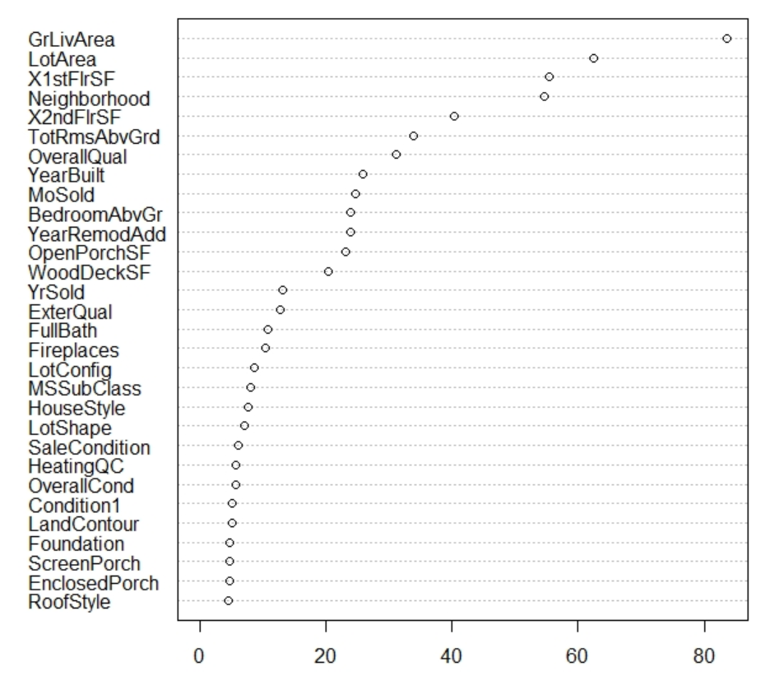
Random Forest as the base learner for classification
Base learner
Random forest with 500 trees, increasing the trees further didn’t improve the classification performance
Validation Error: 16.5% | Test Error: 13.8%
Random forest can be a good starting point for our ensemble as its already a group of predictors and observations tied up together
As it samples both observations and features, it reduces the overfitting considerably
Mean Decrease Gini

Slide 4
SVM, LDA, Boosting and other learners - standalone performance
Variable importance from random forest was helpful in variable selection while building other learners
Inference
SVM radial kernel has overfit in the training dataset, and its evident in validation performance
Classification task hand is easy. ‘GrlivArea’ and ‘OverallQual’ variables are strong predictors
Random forest should have strong trees that are tied together, difficult to surpass their performance
SVM with linear kernel has outperformed the rest of the classifiers in test and validation*
Ensemble of these methods might not be better than every individual classifiers
* Randomly sampled test and validation dataset might be biased

Slide 5
Ensemble – Listen to Everyone, Anyone, A few?
Strategy
Bagging, Boosting and Random Forest - Multiple decision makers - Will it work always?
Voting - Majority of the votes favoring which class - Equal weightage to the every classifier
Weighted average - Aggregate the decisions across all the classifiers - Based on test accuracy?
Hierarchy - Listen to one of the classifier blindly if its 1, if 0, listen to the others - how to decide?
Stacking - Layering predictors on top of base learners - NFL Theorem
Inference
Based on the standalone performance of the classifiers, SVM linear kernel was better than Random Forest
Different combinations of the base classifiers doesn’t perform as good as SVM linear kernel / Random Forest
Hierarchy based ensemble would also not result in significantly better performance compared to the standalone classifiers

Slide 6
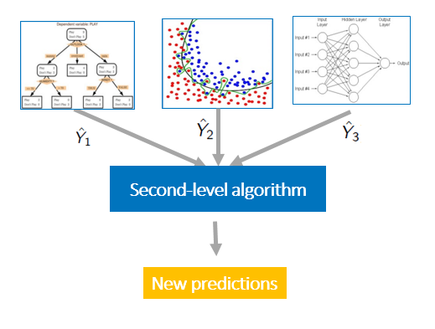
Summarizing the results from different classifiers - Stacking
Boosting
Logistic Regression
LDA
Random Forest
SVM (Linear, Radial)
Features - X
Base learners
Response - Y
Second level prediction
Final prediction
Pros: Summarizes the first layer prediction, another chance to improve the predictions
Cons: Complete loss of interpretability as the predictors are masked by the second level algorithm

Slide 7
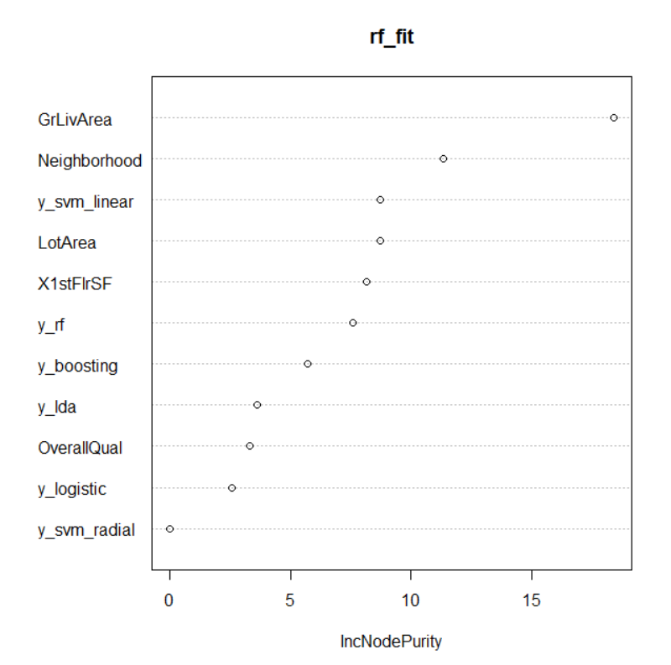
Stacking layer Random Forest variable importance

Slide 8





Stacking Analogy
Ethics
Future
Sales Head
Operations Head
Cash flow
Efficiency
Marketing Head
Finance Head
Perception
Profit

Slide 9


Good practices and not so good practices in stacking
First layer
Using same set of raw predictors in the base classifiers
Good performing classifiers
Non-correlated predictions from base classifiers (The backbone of Random Forest)
Bad base classifiers
Stacked layer
Leveraging raw predictors on top of first layer predictions
Random Forest, NN are good stacking layers
Sticking with just the first layer predictors
KNN, PCR are known for being a bad stacking layers
KNN - too many ties
PCR and LR were not as accurate than base classifiers
Random Forest with 6 first layer predictions and 5 raw predictors had 98.1% test accuracy

Slide 10
Key takeaways
Objective
The simplicity in the objective helps in building inferential, parsimonious, implementable models
Gathering information about the task in hand. Both features and also subject matter expertise
Creative and free hand sketching while feature engineering, interaction variable definition etc.
Base learners
Depending on the objective, choose the base learners. EDA helps with insights and hypotheses
Exploration on methods and inter variable relationships help in taking key calls while prediction
Improvise through Ensemble
Better if the predictions from base learners are not correlated, everyone adds value to the table
Stacking up models wouldn’t always lead to better results. No Free Lunch without ‘effort’
Leverage the raw predictors in the stacking layer along with first layer predictions

Slide 11

Let’s ensemble

